Slide 1
網頁設計

Slide 2
專案介紹
Website Name : Global-Warning
Purpose : Show the recent global Issue about the climate change.
Global-Warning is the website
showing the recent news, article,
or research about global environment,
even the activity that is on-going.

Slide 3
緣起與創作原因
U.S. president decided not to participate the Paris Agreement, and think that the climate change and the global warming is just a researcher's prank, but the the climate did change, so we want to create a platform that can spread the notification of climate change.
Global warming is already be the global issue for recent few years, and the most efficient way to spread idea through the global is internet, so we decide to make "Global-Warning" with website way, that can let the people who interest this area more easily view on internet.

Slide 4

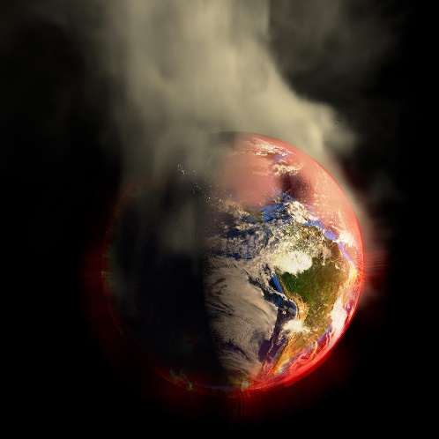
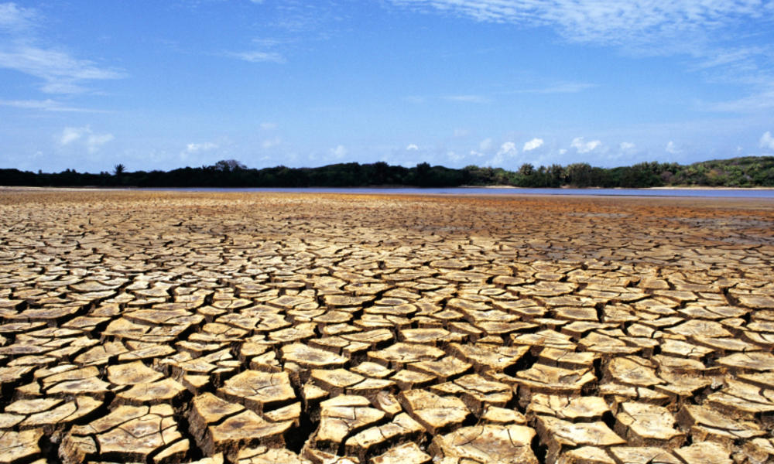
解決現階段何種問題

Slide 5
專案特色說明
多功能整合(教育、新聞、論壇)
全球暖化為國際議題，網站內容全英文

Slide 6
目標對象
關注全球議題的人
未有危機意識的人
想了解氣候變遷對我們影響的人

Slide 7
情境說明
學校的環境教育課程
新聞報導參考

Slide 8
網站功能
蒐集最新的氣候變遷報導
提供最新關於政策的訊息
提供目前正在進行中的全球活動動態
提供關於全球暖化及氣候變遷的相關知識
密切觀察相關人員動態
提供贊助的功能

Slide 9
網站架構

Slide 10
未來規劃

Slide 11
佈局規劃

